Slide 1


Foundations of
Scientific Computing
(SciComp 101)
Dave Biersach
dbiersach@bnl.gov
Session 20
Monte Carlo Estimation

Slide 2
Session 20 – Goals
Understand the principles behind the Monte Carlo method
Compare the accuracy when estimating the area of a 2-D unit circle using two different sampling methods
Fixed sampling across a uniform grid of points
Variable sampling using a set of random points
Appreciate the impact of minimizing discrepancies when using Monte Carlo estimation techniques
Pseudo-random number generator (PRNG) – Permuted Congruential Generator
Quasi-random number generator (QRNG) – Halton Sequence

Slide 3
Session 20 – Goals (cont.)
Estimate the volume of a 3-D unit sphere using a QRNG-powered Monte Carlo approach
Consider the "curse of dimensionality" as it relates to estimating the volume of hyperspheres
Use Monte Carlo to estimate the content of an n-ball using integer dimensions
Develop a closed-form (analytic) formula for n-ball content based upon Euler's Gamma function
Calculate the area under a parabola and the standard normal PDF using the Halton QRNG
Properly generate uniformly distributed random sample points inside a 2D circle

Slide 4
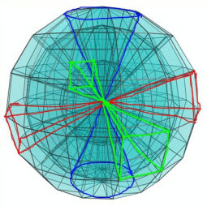
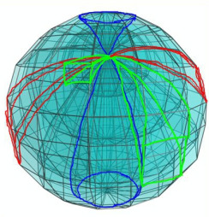
An Interesting Question
What is the volume of a four-dimensional unit hypersphere?
What does a 4D sphere “look” like?
What is a “unit” sphere?
Where do I even start?
Break down complex questions into simpler steps:
How can we calculate the area of a 2D circle?
How can we calculate the volume of a 3D sphere?
How do we move from 3D to 4D?

Slide 5
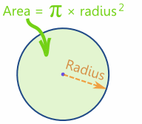
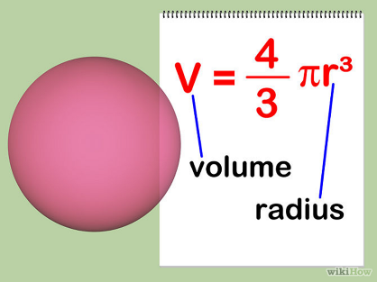
Area and Volume

Slide 6
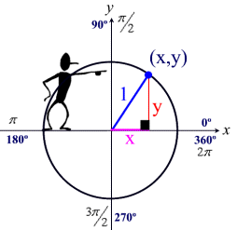
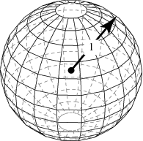
A Unit Circle and Unit Sphere

Slide 7
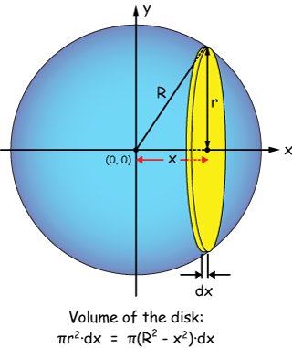
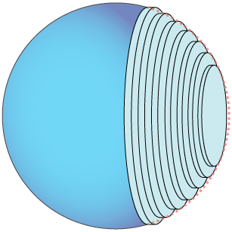
2-D Area → 3-D Volume

Slide 8
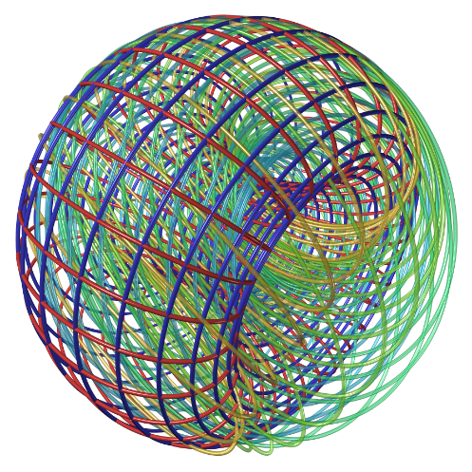
A 4-D Hypersphere
How do we calculate the volume of something we can not even imagine?

Slide 9
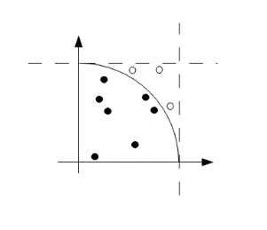
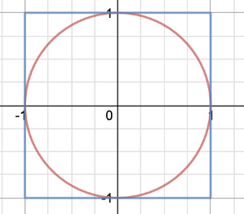
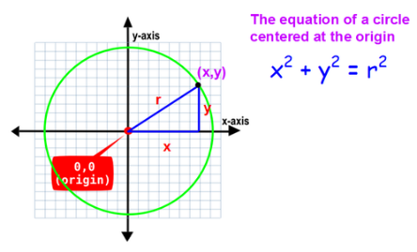
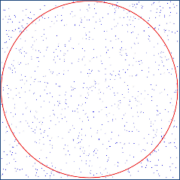
Area as a “Ratio” of Inside vs. Total Dots
Generate a large number of random points and count how many are inside the circle

Slide 10
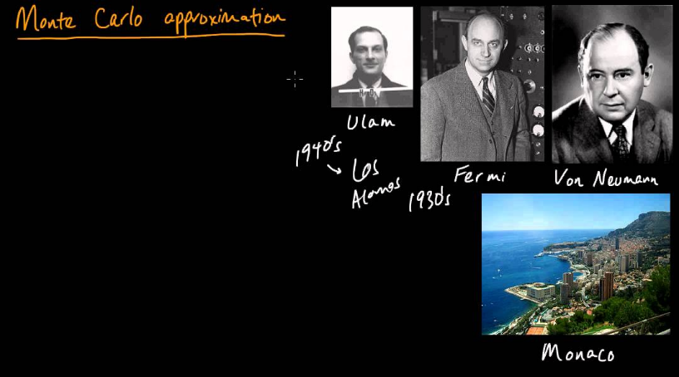
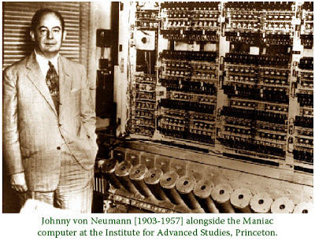
The Monte Carlo Method

Slide 11
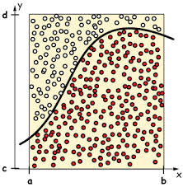
The Monte Carlo Method
With Monte Carlo, we randomly sample points within a bounded space and count how many are inside the curve
The ratio of inside dots (those under the curve) vs. total dots leads to an estimate of the integral
Monte Carlo is non-deterministic when a random number generator is used to create the sample points

Slide 12
The Monte Carlo Method
We don’t know this area
$$f\left(x\right)$$
$$\frac{{dots}_{inside}}{{dots}_{total}}=\frac{{area}_{ curve}}{{area}_{sample}}$$
$${area}_{sample}=\left(b−a\right)×\left(d−c\right)$$
$${area}_{ curve}={area}_{sample}×\frac{{dots}_{inside}}{{dots}_{total}}$$

Slide 13
The Monte Carlo Method
(-1,1)
(1,1)
We don’t know this area
r = 1
$$\frac{{dots}_{inside}}{{dots}_{total}}=\frac{{area}_{ circle}}{{area}_{sample}}$$
$$height=2$$
(0,0)
$${area}_{sample}=base ×height$$
(-1,-1)
(1,-1)
$$=2×2$$
$$=4$$
$$base=2$$
$${area}_{ circle}=4×\frac{{dots}_{inside}}{{dots}_{total}}$$

Slide 14
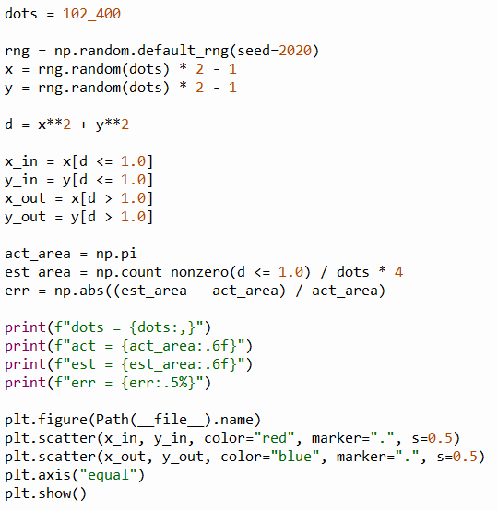
Open mc_circle_prng.py
①
②
③
④
⑤
Absolute Percentage Error (APE)
⑥
⑦
⑧
⑨
$${area}_{ circle}=\frac{{dots}_{inside}}{{dots}_{total}}×4$$
⑩

Slide 15
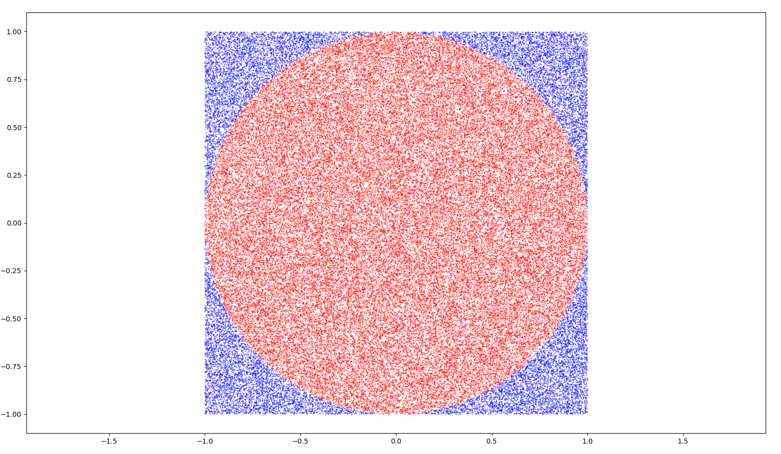

Run mc_circle_prng.py

Slide 16
Monte Carlo Methods
Using nothing but random dots, we were able to estimate the area of a unit circle to within 0.09230% error
That is not 9% error, which wouldn’t be very good, but rather 0.09230% error, which is very good, and we only used 102,400 dots to achieve this accuracy
But it is natural to ask: must we use random dots?
What if we just took dots following a uniform grid covering the same sample area as we did with the random dots?
If we take the same number of dots (102,400) across the grid it would seem fair to what we did using random dots
What is so magical about using random dots?

Slide 17
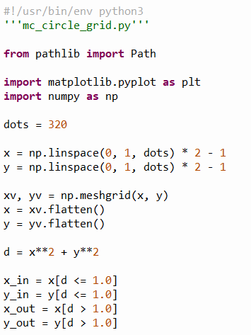
Open mc_circle_grid.py
$$320×320=102,400$$
①
②
③
④
⑤

Slide 18
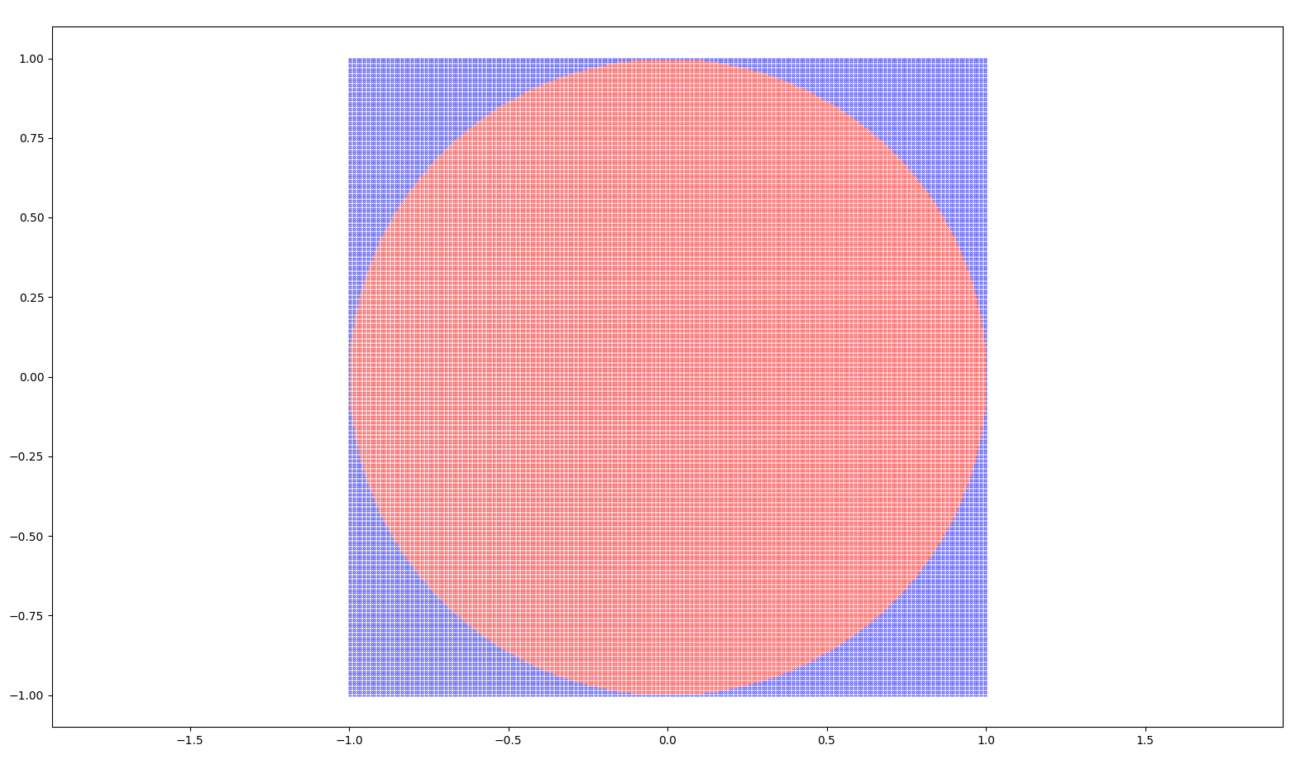

Run mc_circle_grid.py

Slide 19
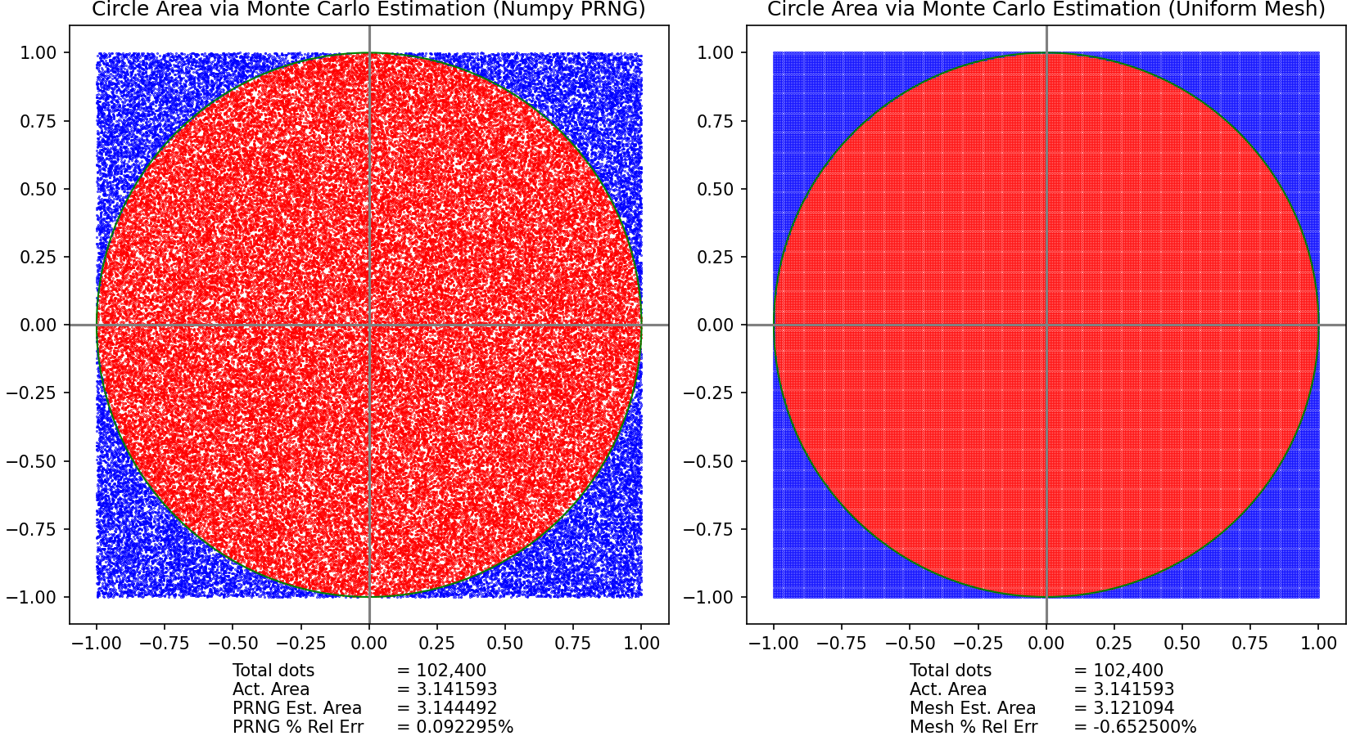


Taking random samples was 607% more accurate than using a uniform mesh!

Slide 20
Monte Carlo Questions
The random Monte Carlo approach and the version based upon taking uniformly spaced samples along a Cartesian (orthogonal) grid used the same number of samples
The MC approach resulted in 607% reduction in relative error compared to the simple grid method – why?
What is the underlying issue that can force a uniformly spaced sampling approach to miscount the dots inside vs. outside the circle?
Consider an individual mesh square that overlaps the perimeter of the circle - how does the rigid placement of the corners of each square affect the accuracy of the estimate of the curve?

Slide 21
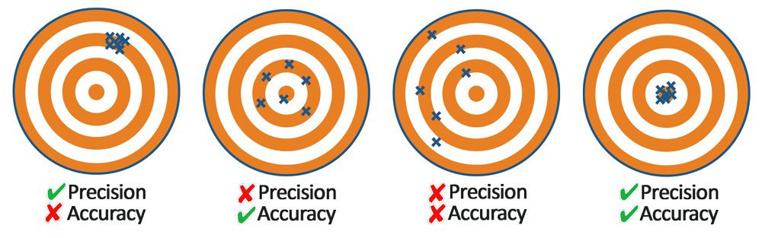
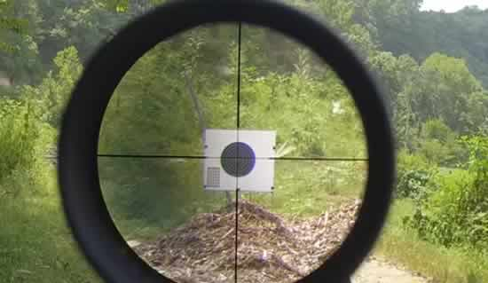
Accuracy vs. Precision
Accuracy = Aim
Hitting what you are aiming at
Precision = Consistency
Digits of Precision $≠$ Accuracy
More digits $→$ less variability

Slide 22
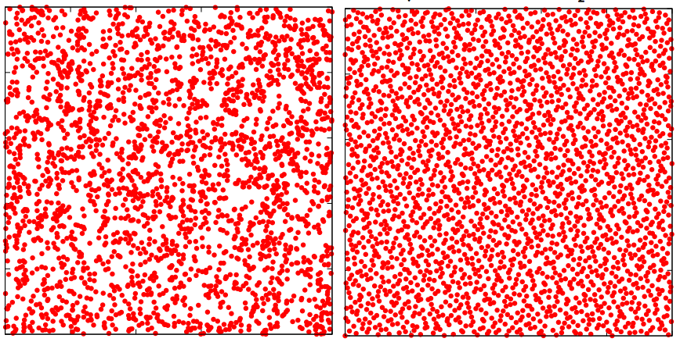
Comparing “Random” Number Generators
A quasi-random number generator
Standard PRNG
Halton QRNG
The Halton sequence generates a smoother distribution of “random” points

Slide 23
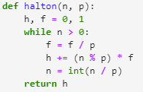
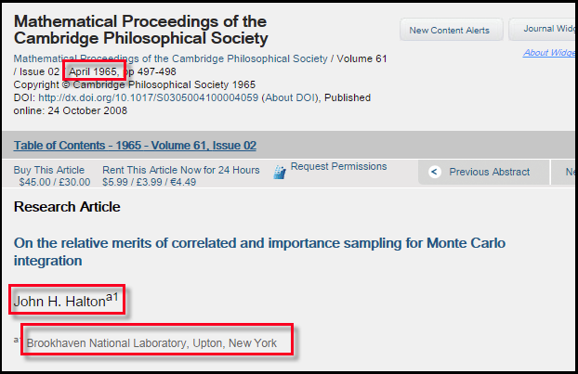
The Halton Sequence

Slide 24
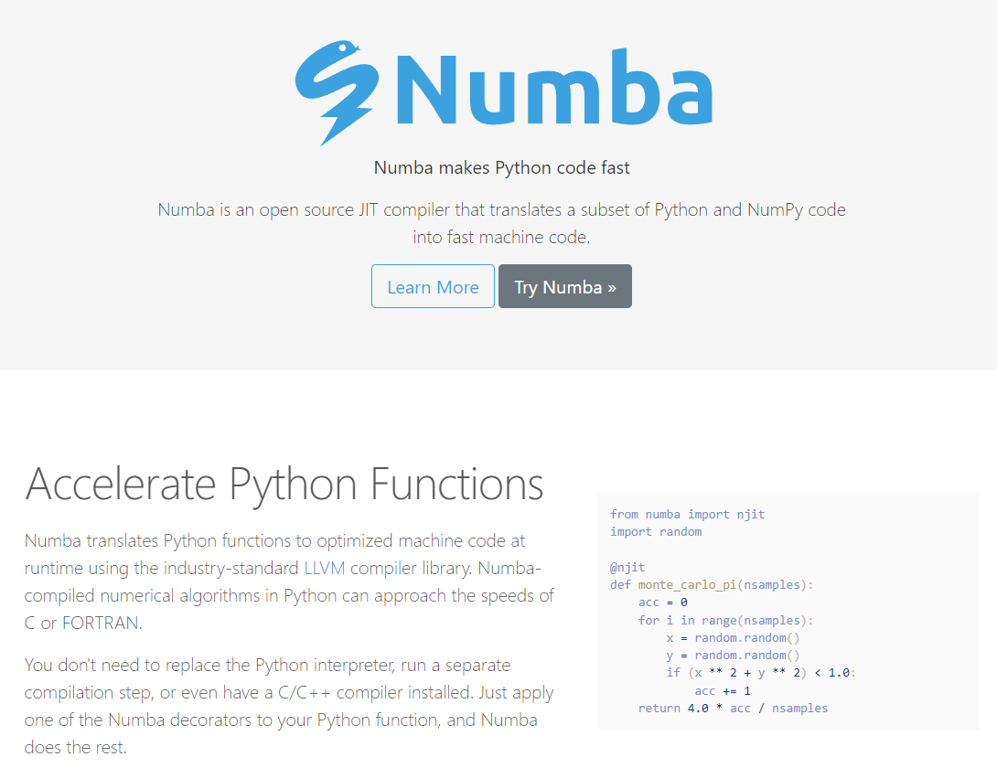
The Numba Package
https://numba.pydata.org

Slide 25
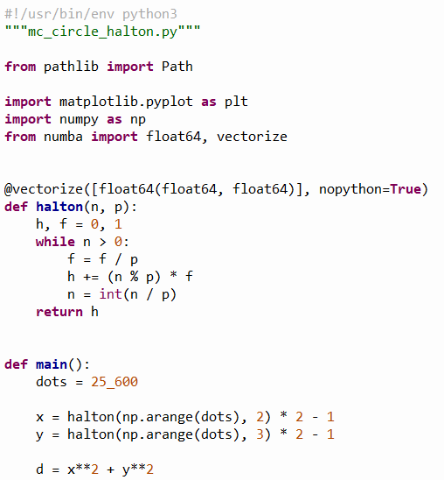
Open mc_circle_halton.py
①
②
③
④
⑤
⑥
⑦

Slide 26
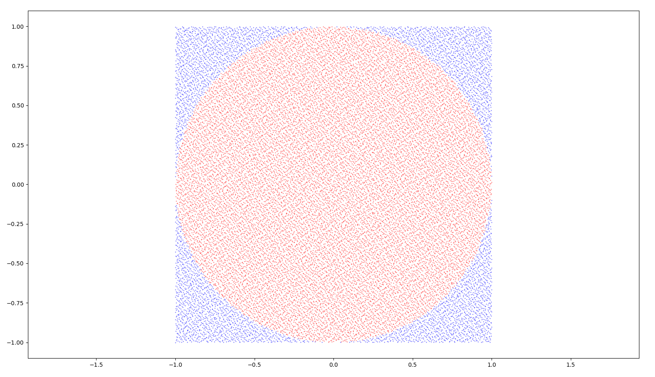

Run mc_circle_halton.py

Slide 27
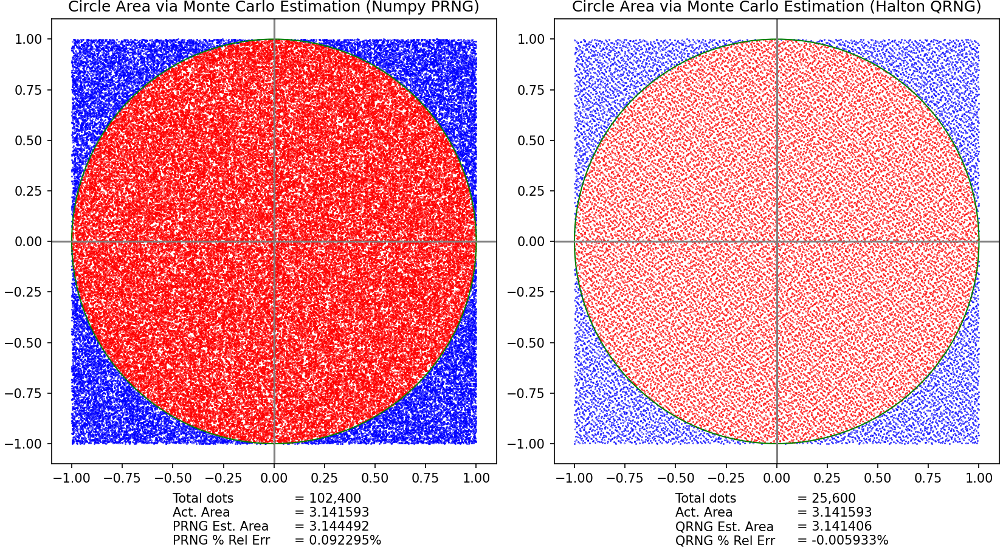
The Halton QRNG MC was 1,456% more accurate than the PRNG MC while needing 300% fewer samples!

Slide 28
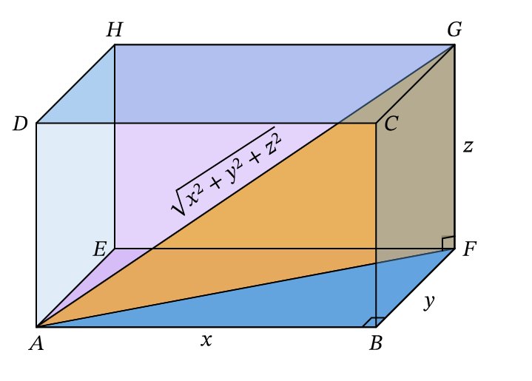
Pythagorean Theorem

Slide 29
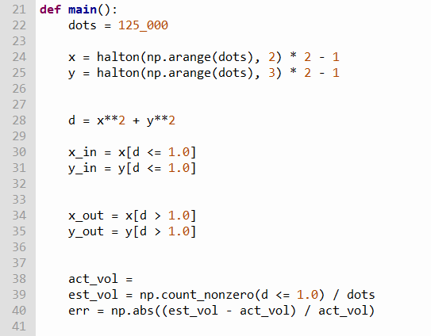
Open mc_sphere.py
The sample volume is
$$2×2×2=8$$

Slide 30
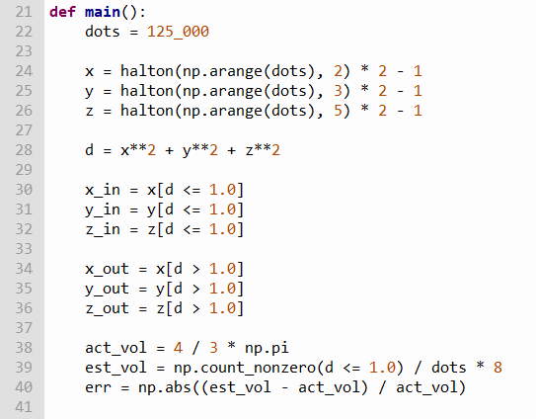
Edit mc_sphere.py
The sample volume is
$$2×2×2=8$$

Slide 31
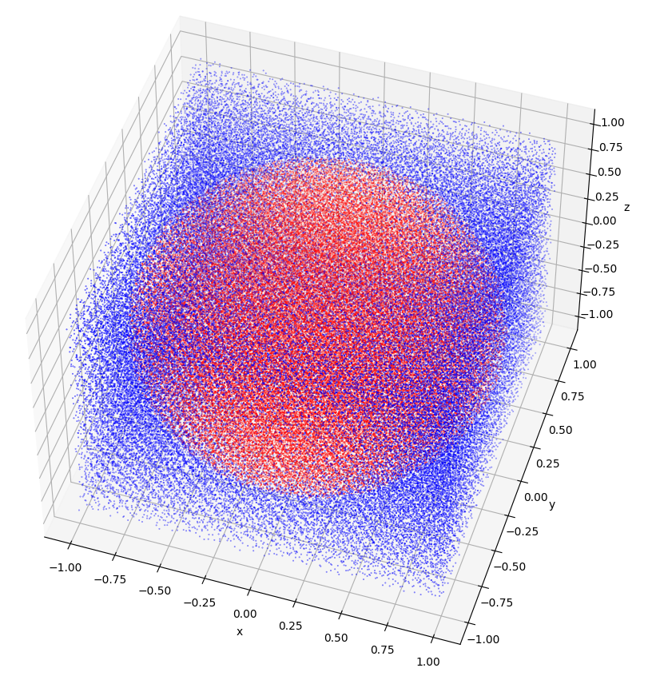
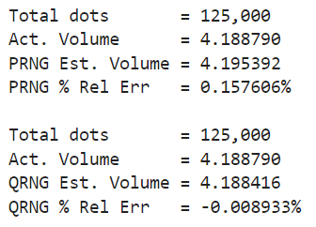

Run mc_sphere.py
We just estimated the volume of a unit sphere to within 0.009% without a stitch of calculus and using nothing but random numbers!
The QRNG was 1,664% more accurate than the PRNG

Slide 32
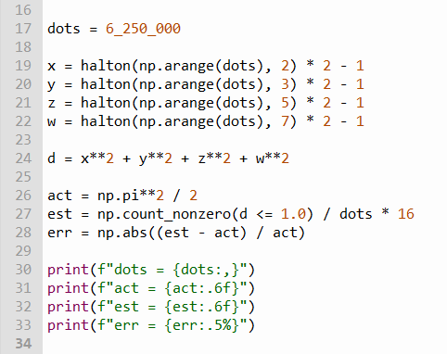
Open mc_hypersphere.py
Incorporating the 4th dimension…
①
②
③
④

Slide 33

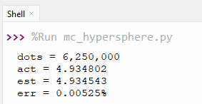
Run mc_hypersphere.py
What is the content of a 4-D unit hypersphere?
= $\frac{π^{2}}{2}$
Yes, we can calculate the content of something we can not even imagine!

Slide 34
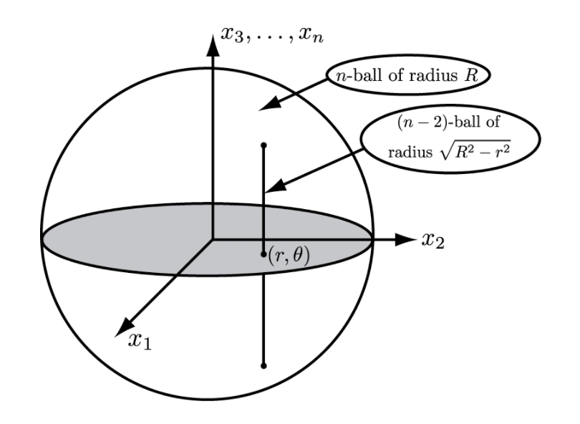
A Recurrence Relation
The content of an $n$-ball is proportional to the unit ball for that dimension
We can compute $V_{n}\left(1\right)$ by integrating the $n−2$ ball over a unit disk using polar coordinates
$$V_{n}\left(1\right)=\int_{0}^{1}{\int_{0}^{2π}{V_{n−2}\left(1\right){\left(\sqrt{1−r^{2}}\right)}^{n−2}rⅆθⅆr}}$$
$$V_{n}\left(R\right)=V_{n}\left(1\right)R^{n}$$
$$=V_{n−2}\left(1\right)\int_{0}^{1}{r{\left(1−r^{2}\right)}^{\frac{n−2}{2}}{\left.θ\right|}_{0}^{2π}ⅆr}$$
$$=2πV_{n−2}\left(1\right)\int_{0}^{1}{r{\left(1−r^{2}\right)}^{\frac{n−2}{2}}ⅆr}$$
$$V_{n}\left(1\right)=\frac{2π}{n}V_{n−2}\left(1\right)$$

Slide 35
A Recurrence Relation
$$V_{n}\left(1\right)=\frac{2π}{n}V_{n−2}\left(1\right)$$
$$V_{n}\left(R\right)=V_{n}\left(1\right)R^{n}$$
Point
(by definition)
$$V_{o}\left(1\right)=1$$
$$0!=1$$
$$V_{o}\left(R\right)=1$$
$$n=0→R^{n}=R^{0}=1$$
Line
$$1−\left(−1\right)=2$$
$$V_{1}\left(1\right)=2$$
$$V_{1}\left(R\right)=2R$$
$$V_{2}\left(1\right)=\frac{2π}{2}\left(1\right)=π$$
$$V_{2}\left(R\right)=πR^{2}$$
2D Circle
3D Sphere
$$V_{3}\left(1\right)=\frac{2π}{3}\left(2\right)=\frac{4}{3}π$$
$$V_{3}\left(R\right)=\frac{4}{3}πR^{3}$$
$$V_{4}\left(1\right)=\frac{2π}{4}\left(π\right)=\frac{π^{2}}{2}$$
$$V_{4}\left(R\right)=\frac{π^{2}}{2}R^{4}$$
4D Hypersphere

Slide 36
Volume via the Gamma Function
A Point
$$V_{n}\left(R\right)=\frac{π^{\frac{n}{2}}R^{n}}{Γ\left(\frac{n}{2}+1\right)}$$
$$V_{0}\left(R\right)=\frac{π^{\frac{0}{2}}R^{0}}{Γ\left(\frac{0}{2}+1\right)}=\frac{1}{\left(1−1\right)!}=1$$
$$Γ\left(n\right)=\left(n−1\right)!$$
$$n!=Γ\left(n+1\right)$$
$$V_{2}\left(R\right)=\frac{πR^{2}}{Γ\left(\frac{2}{2}+1\right)}=\frac{πR^{2}}{Γ\left(2\right)}=\frac{πR^{2}}{\left(2−1\right)!}=πR^{2}$$
$$V_{3}\left(R\right)=\frac{π^{\frac{3}{2}}R^{3}}{Γ\left(\frac{3}{2}+1\right)}=\frac{πR^{3}}{Γ\left(\frac{5}{2}\right)}=\frac{π^{\frac{3}{2}}R^{3}}{\left(\frac{3\sqrt{π}}{4}\right)}=π^{\frac{3}{2}}R^{3}\left(\frac{4}{3\sqrt{π}}\right)=\frac{4}{3}πR^{3}$$
$$V_{4}\left(R\right)=\frac{π^{\frac{4}{2}}R^{4}}{Γ\left(\frac{4}{2}+1\right)}=\frac{π^{2}R^{2}}{Γ\left(3\right)}=\frac{π^{2}R^{2}}{\left(3−1\right)!}=\frac{π^{2}R^{4}}{2}$$

Slide 37
Volume via the Gamma Function
$$V_{n}\left(R\right)=\frac{π^{\frac{n}{2}}R^{n}}{Γ\left(\frac{n}{2}+1\right)}$$
Because we can evaluate $Γ\left(x\right)$ at every point in $ℝ$ we can now determine the content of a unit hypersphere in any dimension
$$V_{7.89}\left(5.12\right)=\frac{π^{\frac{7.89}{2}}{5.12}^{7.89}}{Γ\left(\frac{7.89}{2}+1\right)}=1,633,106.2809$$
As the Gamma function can extends its domain to include $n∈ℝ$, we can use this analytic solution to compute the volume of hyperspheres having fractional (non-integer) dimensions!

Slide 38
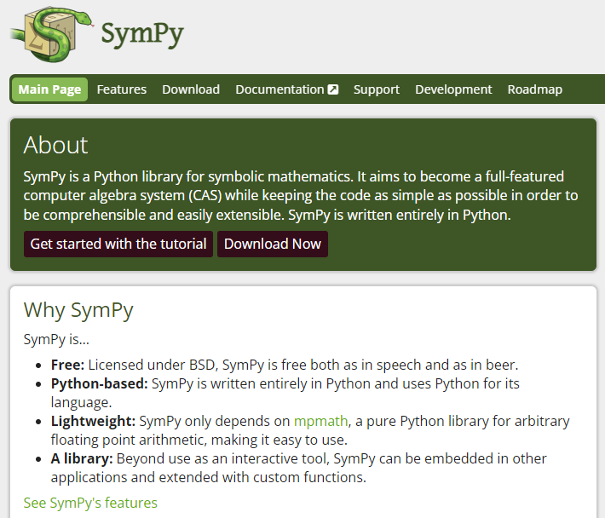
The SymPy Package
https://www.sympy.org

Slide 39
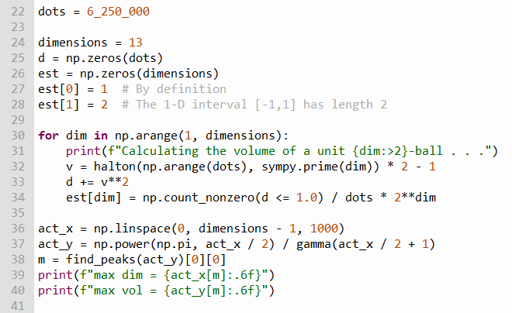
Open mc_high_dimensions.py
①
②
③
④
⑤
⑥
⑦
⑧
⑨
⑩

Slide 40
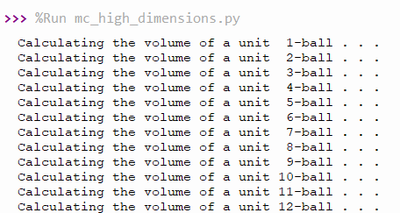
Run mc_high_dimensions.py
What lurks beyond the 4th dimension?

Slide 41
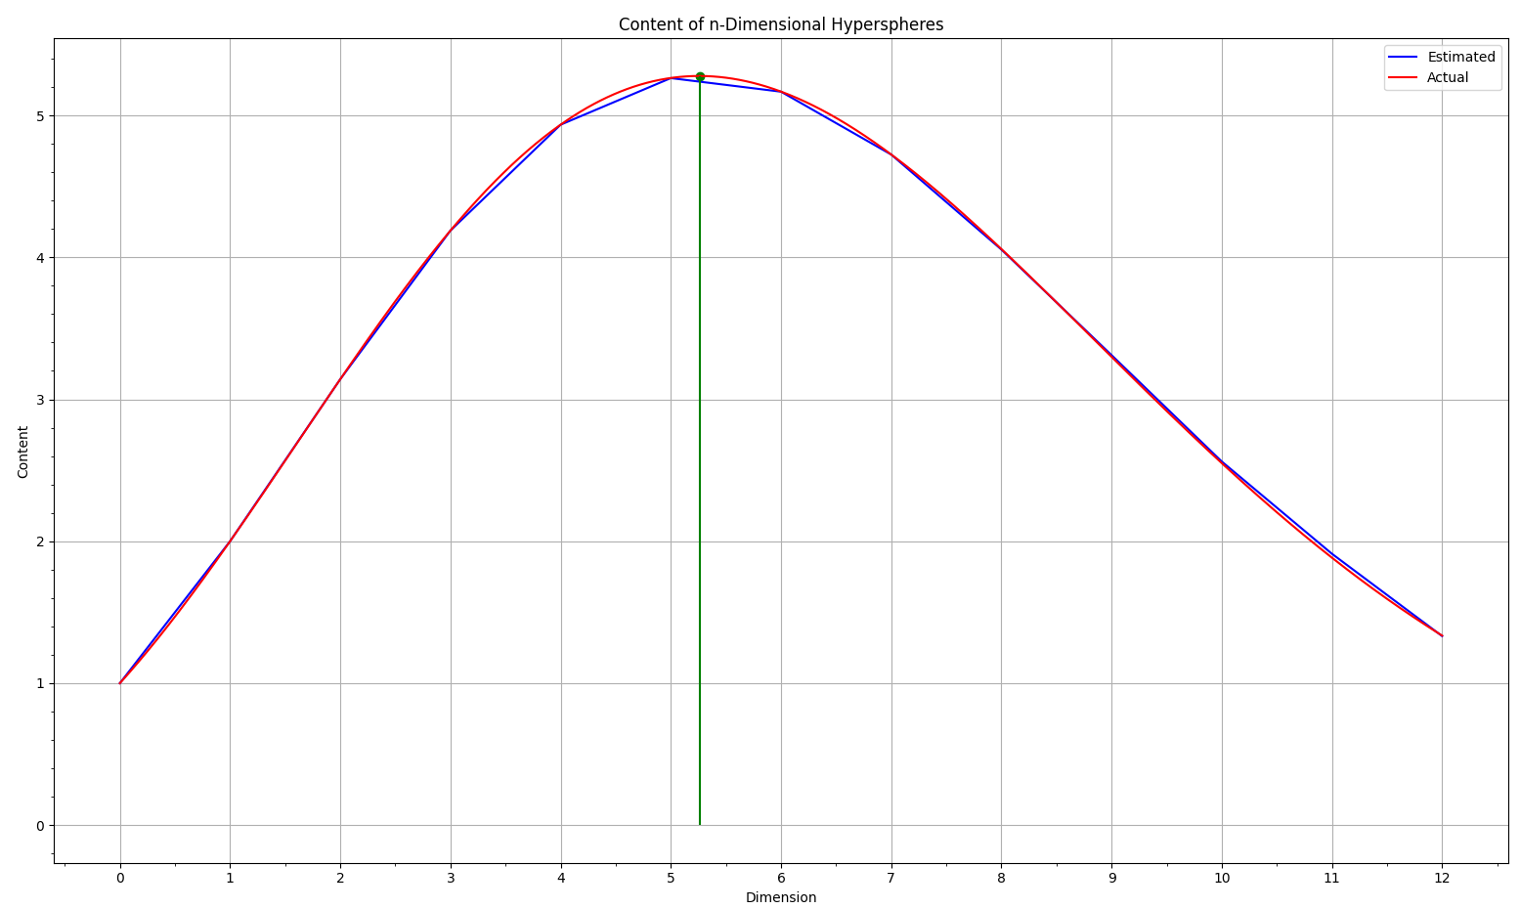
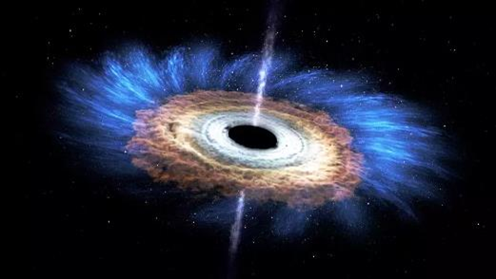

Run mc_high_dimensions.py
What lurks beyond the 4th dimension?
A unit hypersphere with a fractional dimension has the maximum content!
The content decreases in each higher dimension!

Slide 42
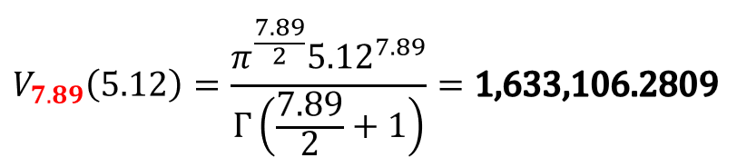
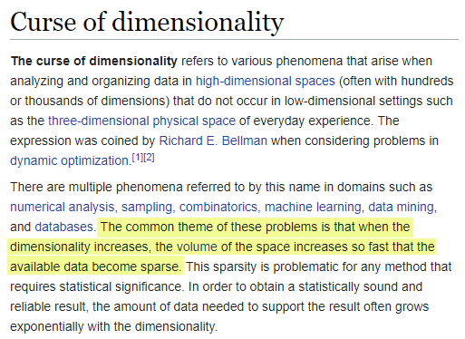
Challenges of Numerical Analysis
Did we use enough dots?
For non-unit n-balls $\left(R>1\right)$

Slide 43
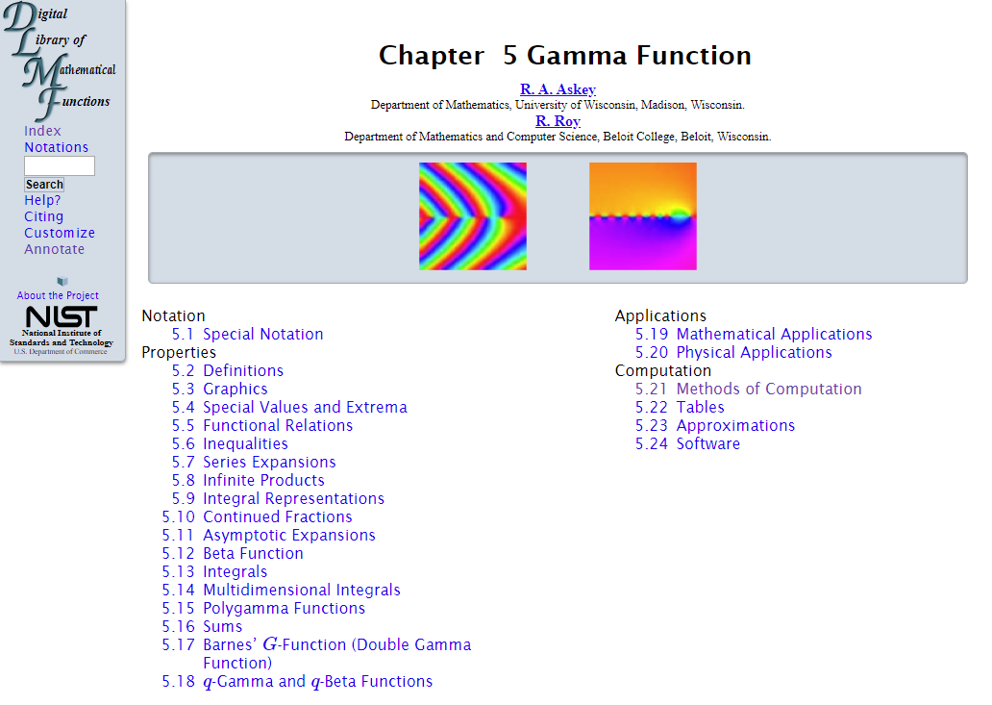
Euler's Gamma Function
https://dlmf.nist.gov/5
Gamma gets its own chapter!
$$Γ\left(x\right)Γ\left(1−x\right)=\frac{π}{\sin{πx}}$$

Slide 44
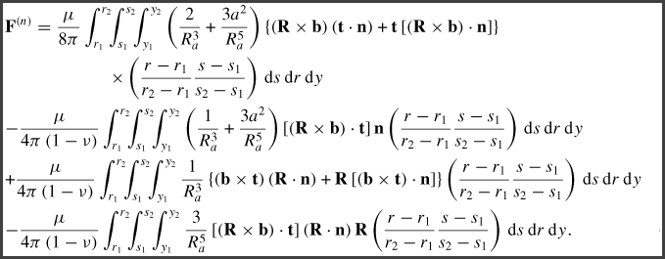

The Power Of Monte Carlo Integration

Slide 45
More Monte Carlo Integration
We can use the principles of Monte Carlo sampling to estimate the area under other types of curves
We must determine which dots are "inside" (underneath) versus "outside" (above) the curve
We must determine the bounds (area) of the sample space
We need to determine the number of samples (dots) required to achieve the desired accuracy & precision
We don’t know this area
$$\frac{{dots}_{inside}}{{dots}_{total}}=\frac{{area}_{ curve}}{{area}_{sample}}$$

Slide 46
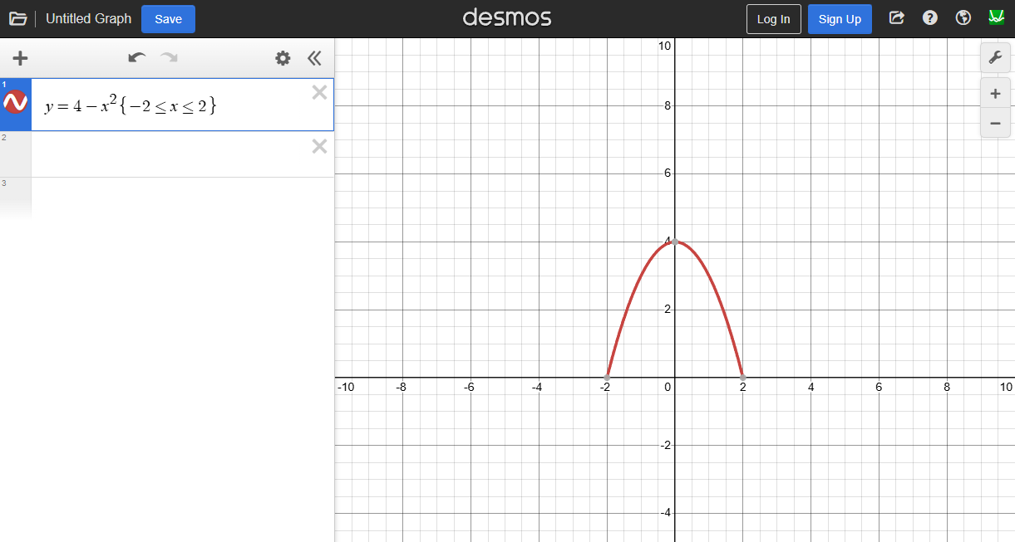
The Parabola Conic Section

Slide 47
The Quadrature of a Parabola
Estimate and display the area under the parabola $y=4{−x}^{2}$ by picking $40,000$ random points within a sample area bounded by $−2≤x≤2$ and $0<y≤5$
Essentially, we are trying to estimate this integral:
$$\int_{−2}^{2}{4−x^{2} ⅆx}$$
From calculus, we know the exact area is $\frac{32}{3}$
Plot sampled points under the curve red, the sample points above the curve blue, and print the actual area, the estimated area, and the absolute percentage error (APE) of the estimate

Slide 48
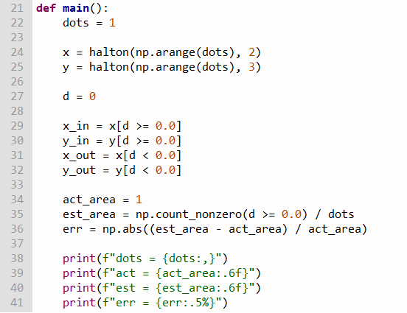
Open mc_parabola.py

Slide 49
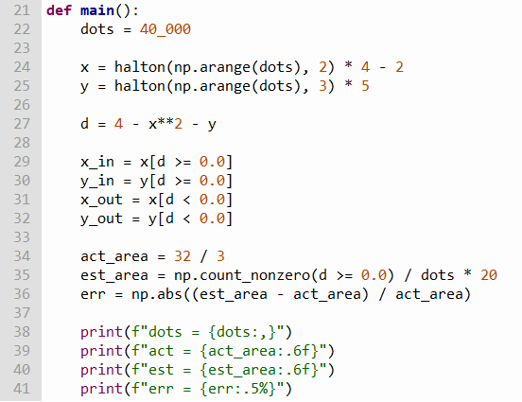
Edit mc_parabola.py
$$−2≤x≤2$$
$$0≤y≤5$$
d is the distance from the random point y to the curve
The sample area is
$$4×5=20$$

Slide 50



Run mc_parabola.py
$$\int_{−2}^{2}{4−x^{2} ⅆx}=\frac{32}{3}$$
Newton never imagined calculating the area using random dots. What will you do with this capability?

Slide 51

The Normal Probability Density Function (PDF)
68.26% (34.13% x 2) of all values following a normal distribution should fall within $±1σ$ from the $μ$

Slide 52


The Normal Probability Density Function (PDF)
As $e$ is the base of the natural logarithm, so too is the Normal Distribution the most fundamental probability distribution

Slide 53

The Normal Cumulative Distribution Function (CDF)
Estimate the probability that a normally distributed random variable will fall within $±$ the first standard deviation $\left(σ\right)$ of its mean $\left(μ\right)$
The integral (the area under the curve) of a probability density function (PDF) indicates the probability that an observation will fall within that interval
A standard normal distribution is where $\left(μ=0, σ=1\right)$

Slide 54

The Normal Cumulative Distribution Function (CDF)
$μ=$ Mean, $σ=$ Standard Deviation
$$f\left(x\right)=\frac{1}{σ\sqrt{2π}}e^{\frac{−{\left(x−μ\right)}^{2}}{2σ^{2}}}$$
For a standard normal distribution,
$μ=0$ and $σ=1$
$$f\left(x\right)=\frac{1}{\sqrt{2π}}e^{\frac{−x^{2}}{2}}$$
Know the difference between indefinite integrals and improper integrals.
But no amount of “polar integration” or elementary methods will produce a closed‐form antiderivative of the Standard Normal PDF in terms of elementary functions.
One must resort to the error function $erf⁡(x)$
Liouville’s Theorem (Differential Algebra)
$$\int{\frac{1}{\sqrt{2π}}e^{\frac{−x^{2}}{2}}ⅆx}=\frac{1}{2}erf\left(\frac{x}{\sqrt{2}}\right)$$
Because no elementary antiderivative exists, $erf⁡(x)$ can only be estimated numerically, which is sad because the Standard Normal Distribution is at the heart of the Central Limit Theorem (CLT)
Joseph Liouville
(1809-1882)

Slide 55

The Normal Cumulative Distribution Function (CDF)
Estimate the probability that a normally distributed random variable will fall within $±$ the first standard deviation $\left(σ\right)$ of its mean $\left(μ\right)$
$$f\left(x\right)=\frac{1}{σ\sqrt{2π}}e^{\frac{−{\left(x−μ\right)}^{2}}{2σ^{2}}}$$
(-1, 0.5)
(1, 0.5)
(-1, 0)
(1, 0)

Slide 56
The Normal Cumulative Distribution Function (CDF)
Estimate the probability that a normally distributed random variable will fall within $±$ the first standard deviation $\left(σ\right)$ of its mean $\left(μ\right)$
$$f\left(x\right)=\frac{1}{σ\sqrt{2π}}e^{\frac{−{\left(x−μ\right)}^{2}}{2σ^{2}}}$$
(-1, 0.5)
(1, 0.5)
$${area}_{ curve}=\frac{{dots}_{inside}}{{dots}_{total}}∗{area}_{sample}$$
$${area}_{sample}=2∗0.5=1$$
$${area}_{std normal}=\frac{{dots}_{inside}}{{dots}_{total}}$$
(-1, 0)
(1, 0)

Slide 57

Open mc_std_normal.py
$$f\left(x\right)=\frac{1}{\sqrt{2π}}e^{\frac{−x^{2}}{2}}$$
①
②
③
④
d is the distance from the random point y to the curve
⑤
⑥
⑦
⑧
⑨

Slide 58


Run mc_std_normal.py
This area is the same as the probability of a normally distributed random variable falling within the first standard deviation away from its mean
☺

Slide 59
Understanding Probability
The probability of a continuous random variable having an exact value is zero!!
We can never measure continuous distributions exactly
The measurement changes as we increase magnification/precision
Accumulating statistics may enable accurate trend prediction
Single events may happen in a non-deterministic manner
Yet the aggregate ensemble behavior might be deterministic
A paradox? Think Lotto: small odds for all, yet someone always wins
Scientific observables are governed by averages
Statistical Mechanics: temperate = average kinetic energy
Quantum Mechanics: Location within the shape of electron orbitals

Slide 60
What Should Students Learn?
The Probability and Statistics Used Most Often at BNL:
Uniform, Normal, Exponential, Logarithmic
Student’s t
Bernoulli, Binomial, Beta
Poisson, Erlang, Pareto
Mean, Mode, Median
Skew, Variance, Std. Dev
Moments of Distribution
Conditional Probability
Bayesian Inference
Gamma, Chi-Squared
Maxwell-Boltzmann
Regression Techniques
Confidence Intervals
Hypothesis Testing
Time Series Analysis
ANOVA
Stochastic Processes
Markov Chains
Clustering Algorithms

Slide 61

Session 20 – Now You Know…
Monte Carlo integration uses random sampling
The method calculates the ratio of the points below the curve to the total number of points – the final ratio is the “area”
It may require billions of samples to provide a reasonable estimate
It may be the only way to take the integral of a very complex function
What you are taught cannot be the limit of your knowledge
The volume of a 4-D unit hypersphere $=\frac{π^{2}}{2}$
In infinite dimensions the volume of all hyperspheres is zero!
A fractional 5-dimensional unit sphere has maximum volume
Mother Nature never said dimensions must be integers!

Slide 62

Task 20
Fix the code in sphere_sampling.py to correct the problem where randomly sampled points across the surface of a 3D unit sphere bunch together at the north and south poles
The naive approach of picking a random poloidal angle $\left(0≤φ<π\right)$ and a random toroidal angle $\left(0≤θ<2π\right)$ does not produce a uniform (fair) sampling across the entire face of the sphere
Consider what it is about the geometry of the sample space, as seen from the basis (perspective) of spherical coordinates, that causes the sampling "density" to deviate from a uniform distribution

Slide 63

Task 05-02 (hint)
What went wrong with our math?
What must we do to sample smoothly?

